Slide 1

A Reference Architecture for Trust over the Internet with Universal Interoperability
Wenjing Chu
Futurewei Technologies, Inc.
OSS Europe - Dublin - September 13-16, 2022
Wenjing Chu

Slide 2
In this talk, we will discuss 3 things
Trust over the Internet / Web
Universal interoperability
A reference architecture to achieve 1 and 2 … with a few case studies

Slide 3
Trust is what is missing in today’s Internet or Web.

Slide 4
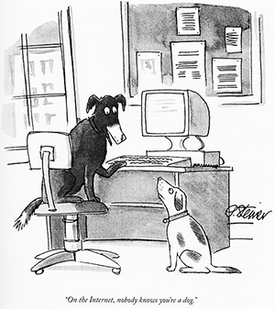

"On the Internet, nobody knows you're a dog"
Notes:
"On the Internet, nobody knows you're a dog" is an adage and Internet meme about Internet anonymity which began as a caption to a cartoon drawn by Peter Steiner, published by The New Yorker on July 5, 1993.

Slide 5
Hey Bob, check out this crypto … Great opportunity! – Ruff
"On the Internet, nobody knows you're a dog"
Notes:
"On the Internet, nobody knows you're a dog" is an adage and Internet meme about Internet anonymity which began as a caption to a cartoon drawn by Peter Steiner, published by The New Yorker on July 5, 1993.

Slide 6
Trust is a complicated matter …
Who, identity & authenticity
Competence
Benevolence, intent
Reputation, pass experience
The medium itself (i.e. Internet, web, social media…)
… numerous more
Trust is as complicated as humans can be!
So there is no silver bullet to solve all trust problems with technology alone!
But we can help:
Fix the medium (Internet) , reduce the risk
Make tools for people to better handle the risk - therefore open huge new opportunities

Slide 7
Trust is a complicated matter …
Who, identity & authenticity
Competence
Benevolence, intent
Reputation, pass experience
The medium itself (i.e. Internet, web, social media…)
… numerous more
Trust is as complicated as humans can be!
So there is no silver bullet to solve all trust problems with technology alone!
But we can help:
Fix the medium (Internet) , reduce the risk
Make tools for people to better handle the risk
This is the focus of my talk

Slide 8

Hey Bob, check out this crypto … Great opportunity! – Ruff
Notes:
Authenticity is the baseline

Slide 9
Foundational requirement: authenticity
Verifiable unique identification (ID)
Has good control over its environment (autonomy)
Necessary, and largely sufficient.
All other features can be built on top of this foundation.
Simple enough for ALL devices on the Internet.
Notes:
Authenticity is the baseline

Slide 10
Authenticity
Implementation Method 1
(Central or Federated)
Implementation Method 2 (Decentralized, Web3/5)
Implementation Method 3 (Autonomic, WoT)
Notes:
Authenticity is the baseline

Slide 11
Trust Spanning Protocol between endpoints
Authenticity
Implementation Method 1
(Central or Federated)
Implementation Method 2 (Decentralized, Web3/5)
Implementation Method 3 (Autonomic, WoT)
Notes:
Authenticity is the baseline

Slide 12
Commonly reusable trust tasks
Identities, Credentials
Authentication, Passwordless Logins
Payments, Money
Authentic Media Types/Data
Authentic Messaging
Authenticity
Trust Spanning Protocol
Implementation Method 1
(Central or Federated)
Implementation Method 2 (Decentralized, Web3/5)
Implementation Method 3 (Autonomic, WoT)
Notes:
Authenticity is the baseline

Slide 13

Layer 4
Your application
Identities, Credentials
Authentication, Passwordless Logins
Payments, Money
Authentic Media Types/Data
Authentic Messaging
Layer 3
Layer 2
Authenticity
Trust Spanning Protocol
Implementation Method 1
(Central or Federated)
Implementation Method 2 (Decentralized, Web3/5)
Implementation Method 3 (Autonomic, WoT)
Layer 1
Notes:
Authenticity is the baseline

Slide 14
Hey Bob, check out this crypto … Great opportunity! – Ruff
Authenticity
Foundational requirement: authenticity
Verifiable unique identification (ID)
Has good control its environment (autonomy)
Notes:
Authenticity is the baseline

Slide 15


Hey Bob, check out this crypto … Great opportunity! – Ruff
Authenticity
Foundational requirement: authenticity
Verifiable unique identification (ID)
Has good control its environment (autonomy)
Notes:
Authenticity is the baseline

Slide 16
Universal interoperability
How does this architecture enable universal interoperability?
Inspiration from the Internet architecture: IP, TCP/UDP, HTTP/HTTPS …
The authenticity support in the Trust Spanning Protocol <=> reachability support by the Internet Protocol (IP)
It is simple enough for ALL devices on the Internet
It is necessary and largely sufficient (minimal requirement)
More sophisticated features can be based on the basic authenticity support => reusable trust tasks

Slide 17
Universal interoperability
Most implementations already support it, but
Needs to refactored out modularly
Needs to conform to a common standard
Let’s take a look at some examples …

Slide 18
Case Studies with Well Known Implementations
All can be refactored to Trust Spanning layer architecture

Slide 19



Traditional / Current State: Central, Federated, FIDO
https://www.good-crypto.com
Certificate
Certificate authority (CA)

Slide 20

Traditional / Current State: Central, Federated, FIDO
ID:bob123
Password: qwerty
https://www.good-crypto.com
ID:bob123
Password: qwerty
Certificate
Certificate authority (CA)

Slide 21
Traditional / Current State: Central, Federated, FIDO
AuthN
AuthZ
ID:bob123
Password: qwerty
AuthN
UserInfo
ID:bob123
Password: qwerty
e.g . GitHub, Google, Apple …

Slide 22
Traditional / Current State: Central, Federated, FIDO
AuthN
AuthZ
AuthN
UserInfo
e.g . GitHub, Google, Apple …

Slide 23
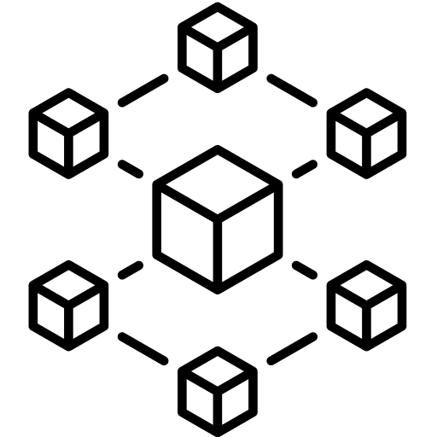
Decentralized: Indy/Aries, DIDComm
DID
DID
Anoncred / DIDComm
Aries client / wallet
Aries client / wallet
Indy blockchain

Slide 24

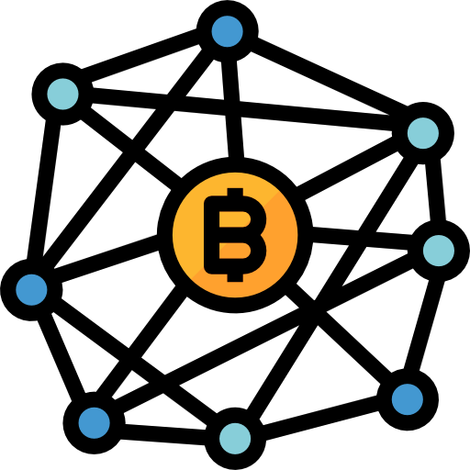
Decentralized Web Platform (DWP) - (aka TBDex) - aka Web5
DID
DID
Verifiable Credentials
IPFS API
IPFS API
IPFS Replication

Slide 25

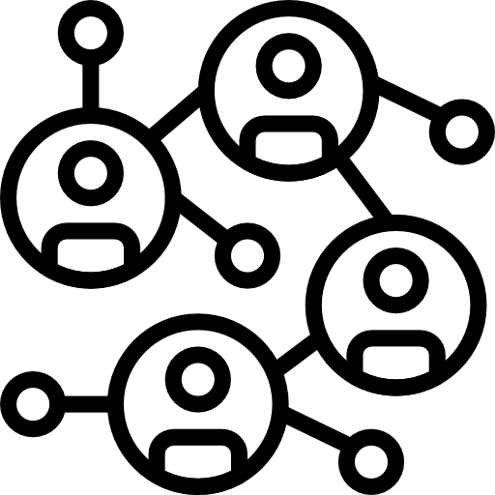
Decentralized: KERI, Web of Trust
AID
AID
Compatible messaging protocols
Pool of Witnesses , Watchers
Pool of Witnesses,Watchers

Slide 26
Key Takeaways
Building a better trust layer is not just a concern for special Internet service such as crypto currencies or payment, but all the valuable activities we do on the Internet.
There are many non-compatible implementations - we need to refactor them into
A base layer of the minimal foundation - i.e. to support authenticity - by the Trust Spanning Protocol as a common standard,
And other trust tasks built on top of this basic trust spanning layer.
This is the right architecture for the Internet and universal interoperability
One or more open source implementations will be a key contribution we can make for a more trustworthy Internet !

Slide 27
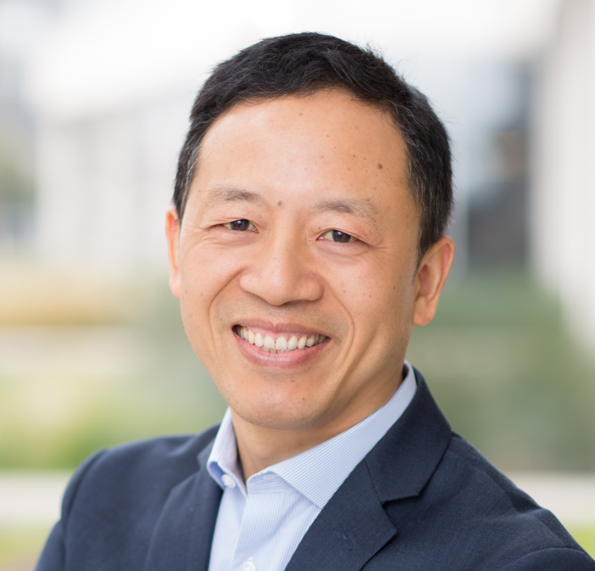
Wenjing Chu
Additional information :
Join my deeper technical presentation in the co-located ToIP Mini Summit:
Wednesday September 14, 2022 14:00 - 17:30 IST
Wicklow Meeting Room 4 (Level 2)
Recorded presentation for the Internet Identity Workshop (IIW 34) - April 2022: https://youtu.be/QZssxxZ9f88
Ongoing work towards a community specification at the Trust over IP Technology Architecture Task Force: https://github.com/trustoverip/TechArch/blob/main/spec.md
Thanks to free icons from flaticon.com for non-commercial use: https://www.flaticon.com/free-icons
Senior Director of Technology Strategy
Futurewei Technologies, Inc.
Thank you !

Slide 28
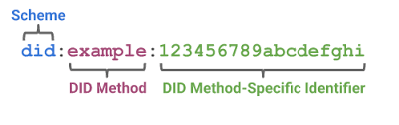
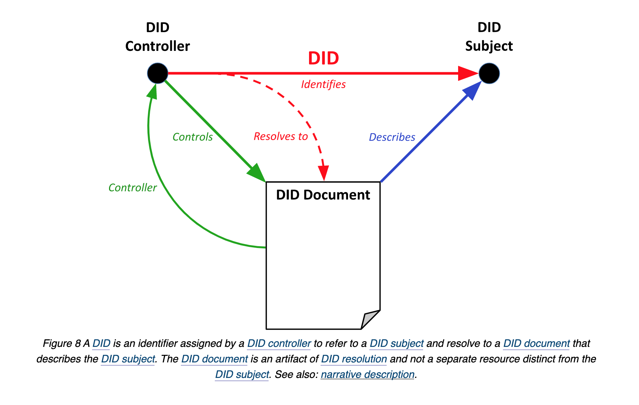
DID Core Spec
W3C DID WG

Slide 29
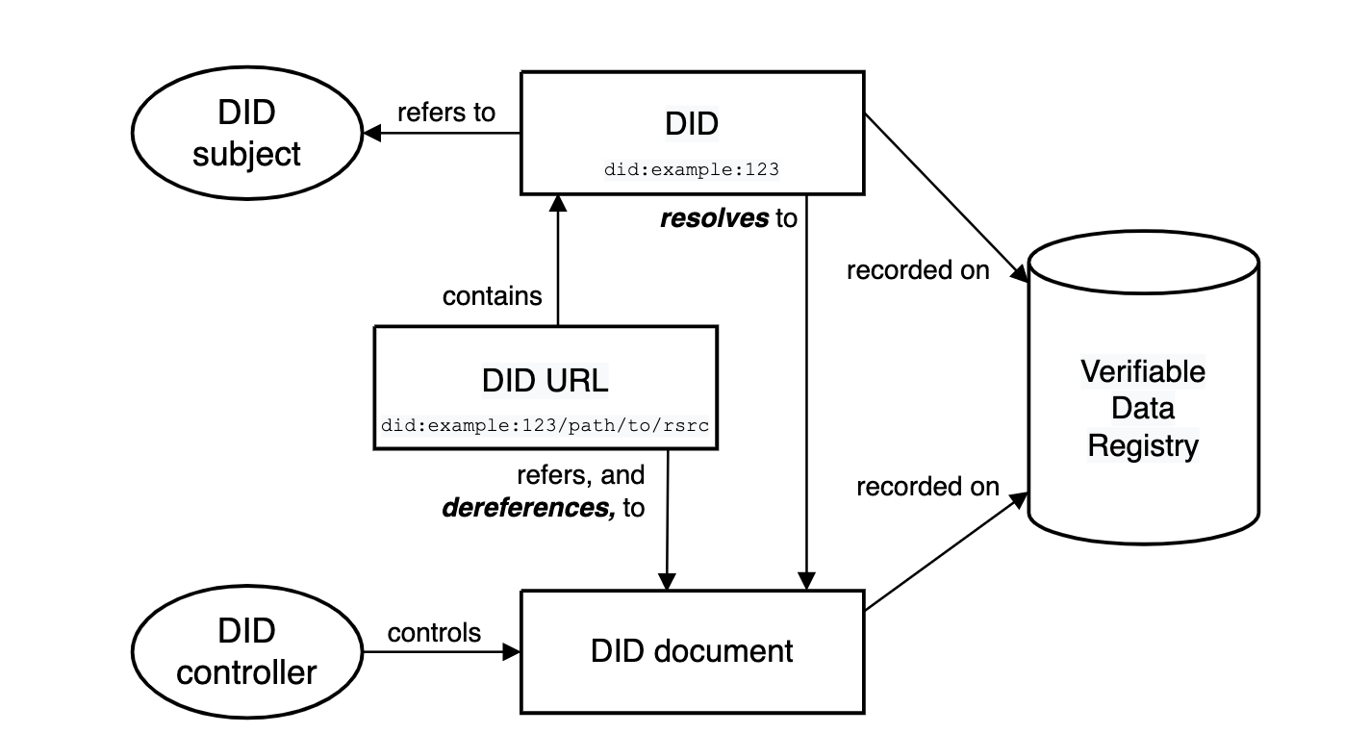
DID Core Spec
W3C DID WG

Slide 30
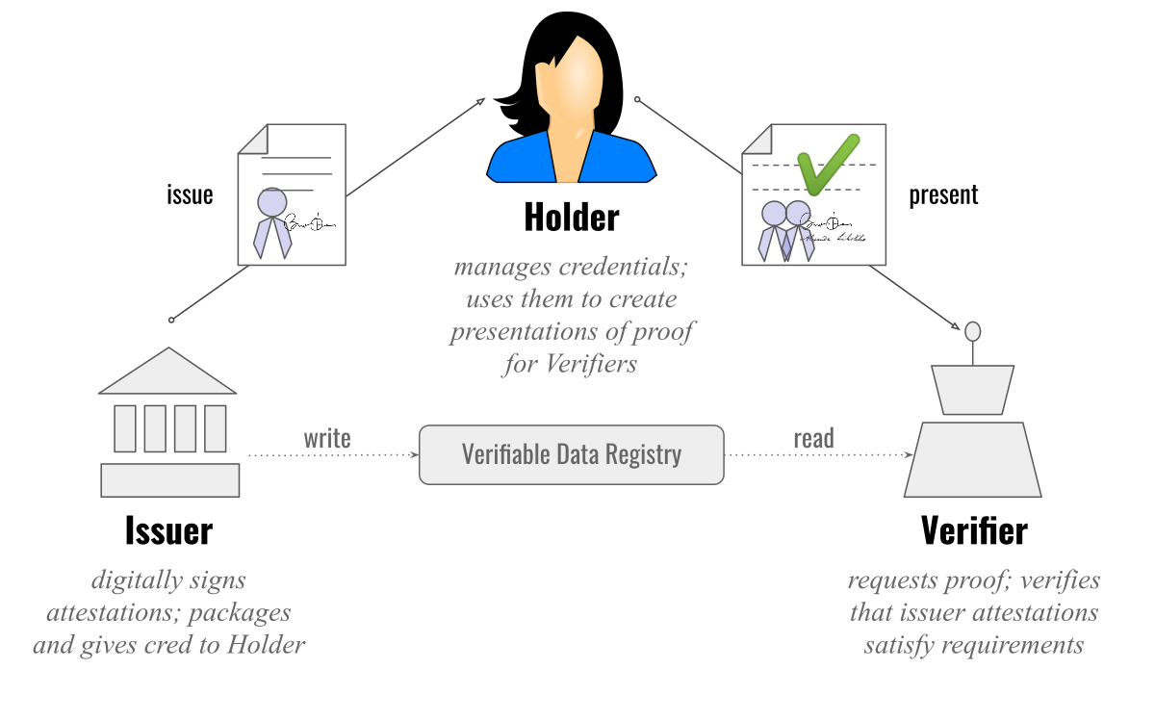
Verifiable Credentials
W3C VC WG

